Slide 1

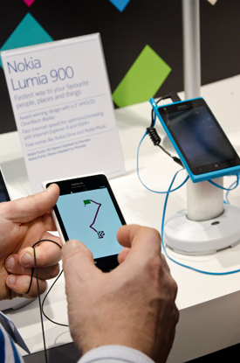
The Nokia Supply Chain

Slide 2
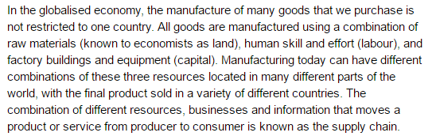

Slide 3
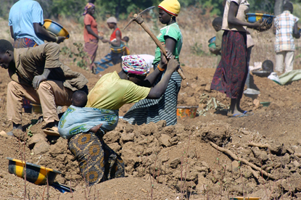
Raw Materials
Notes:
The electronic and electromechanical components of a mobile phone require a variety of minerals, sourced from all over the world. Copper for internal wiring comes mainly from Chile, Australia and Peru, although this important metal is also supplied by other countries in South America, Asia and Africa. Other minerals such as cobalt and tantalum from central Africa, and zinc, mercury and nickel from Africa, Asia, South America and Australia are all required in phone manufacturing. Plastics for the phone cases have to be processed as a by-product of petroleum from the Middle East and other oil producers.

Slide 4
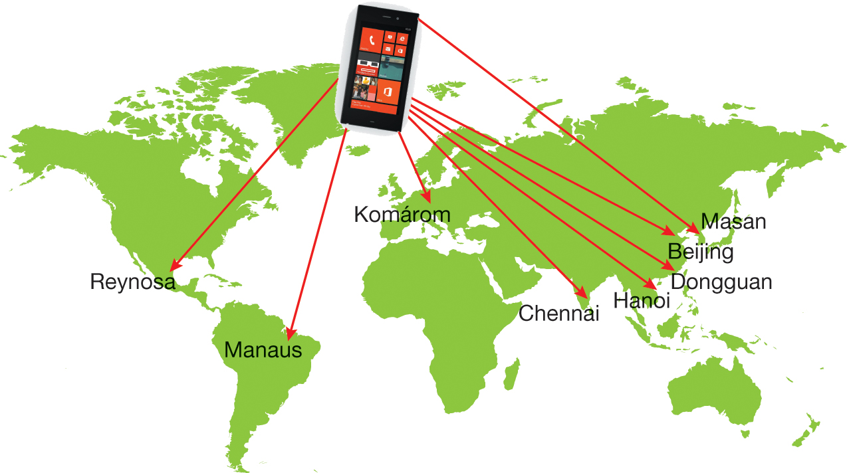
Production of Components
Notes:
Nokia originally made its mobile phones in Finland but, because it was unable to meet demand, opened factories in other locations around the world. For many years Nokia in Finland made a number of phone components itself, and purchased other components from around a hundred different specialist components manufacturers as well as a large number of software suppliers. Electronic circuits, liquid crystal displays, cases and batteries were all then shipped from different parts of the world to be assembled into mobile phones. Since 2011, Nokia has been forced by the competitive nature of the smartphone market to further restructure its operations. In 2012 it closed its last factory in Finland, and now only produces its phones in its remaining eight factories worldwide

Slide 5


Assembly
Notes:
Assembly of Nokia handsets takes place at eight different factories worldwide — Asia, Europe, and North and South America (see previous slide). This is in response to a demand by telecommunications companies in different countries for telephones that have key features under that particular brand. Nokia takes orders from the carriers (such as Vodaphone) into its production system and transforms them into hundreds of thousands of specialised phones for each carrier.
It costs on average $90 to produce a telephone, although this can vary from $20 to $130 depending on the features of the telephone. Nokia then sells its product for 33 per cent more than its production costs.
In 2013 Nokia announced that its phone devices and services division would be sold to Microsoft, to become Microsoft Mobile. This means that the division became part of the Microsoft transnational corporation, and its supply chain became integrated with that of Microsoft worldwide.

Slide 6
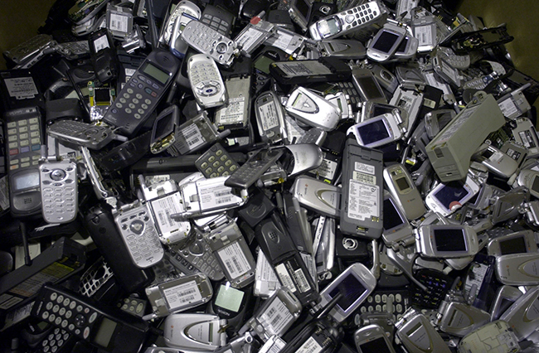
Sustainability
Notes:
Many of the materials used in mobile phones are toxic to both humans and wildlife. Minerals such as coltan, mercury and lead can cause serious problems if they are released into the environment. Plastics, solvents and chemicals such as bromine and chlorine can also be hazardous if they seep into the soil or into the water table. It is important for phone producers to ensure their manufacturing processes do not allow dangerous materials to be released into the environment. The recycling of old mobile phones is also a significant issue.
Nokia is aware of the impacts its products have on the environment. Environmental concerns are built into its operations throughout the product life cycle — including design, production and the minimal use of energy — but it has less control over environmental impacts associated with consumer use and the disposal of old models. Consumers are increasingly encouraged to recycle old phones, and this has helped to reduce the landfill waste associated with the level of technological progress that has taken place.

Slide 7

Nokia Supply Chain Quiz https://create.kahoot.it/share/nokia-supply-chain-quiz/8cd45834-9bd7-4973-ab2b-0252b87baf34

Slide 8
Thinking Question: Investigate another transnational corporation that operates throughout the world and identify the key elements of its supply chain. You could use Nestlé or Ford, or use the internet to find examples of others. Present your information in the form of a flowchart or map on OneNote.

